Slide 1
IPAD RESTAURANT APPLICATION
Christopher Phan, Damola Jimoh, Izien Iremiren
Group 1
https://github.com/SPM-OT/lab-5-group-1.git

Slide 2
INTRODUCTION
OBJECTIVES AND MEASURES OF SUCCESS
RISKS ASSOCIATED WITH THE PROJECT
ACTIVITY DIAGRAM
GANTT CHART

Slide 3
INTRODUCTION
The objective of this project is to create an Ipad restaurant app that eliminates the common issues found in other restaurant applications today.
This includes problems like not being able to have a visual presentation of the dishes in the menu, not knowing how much food to expect, whether a dish is available or out of stock and a few other issues.

Slide 4
OBJECTIVES
Enhance communication between customers and waiters/waitresses by allowing the customer to state their dietary needs and what they desire in a dish.
Aid customers in searching orders by displaying a daily-refreshed image or clip of each dish.
The objective for this application would also help speed up the process of delivering food to others.
The application will also have a simple and easy to read user interface while also giving all the necessary information required for the customers.
Allow customers to leave feedback and recommendations on orders they made and the restaurant/hotels they ordered from to help other customers in deciding what dish they want.

Slide 5
MEASURES OF SUCCESS
Database failure rate for daily updates did not exceed the maximum rate specified in the requirements.
Restaurant/hotels have easy and available access to their database on the application.
The system also has a database for each restaurant that is signed up to use the app.
The project costs did not exceed the funds provided for the project.
More than half of the restaurants/hotels using the applications reported a significant decrease in incorrect or returned orders.
85% of total customer feedback and ratings during the deployment and testing phase were positive.
70% of users during the testing phase reported that the application interface was easy to use and understand.

Slide 6
RISKS ASSOCIATED WITH PROJECT
Partnering restaurants and apps companies may fail to meet deadlines. This can be solved by clearly stating expectations and the consequences of them not being met and listening to the reasons for the late deadline so as to find a solution to it together.
There may be installation problems with later and newer Ipad versions due to the difference in the operating system versions. This can be solved by checking for patterns in the operating system configuration and using this to make the app interoperable.
There might be lagging in the app due to exponential increase in customers, this could be solved by minimizing the line of codes when building the application.
There might be loss of information due to connectivity problems between the customers Ipad and the Restaurants Ipad. This can be solved by ensuring the network it is connected to is always open.
The food quality might be inconsistent , in that case regular anonymous surveys will be done at participating restaurants to check the quality of the food.

Slide 7
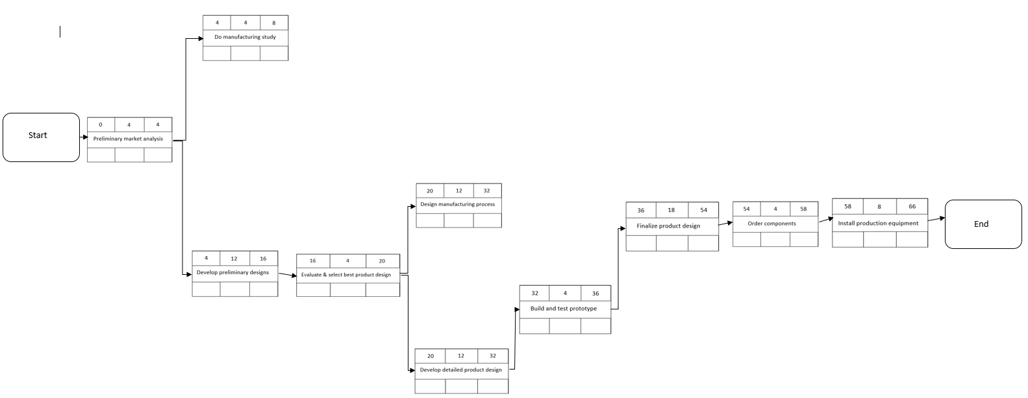
ACTIVITY DIAGRAM

Slide 8
CONCLUSION
Thank You!
Group 1

